Slide 1
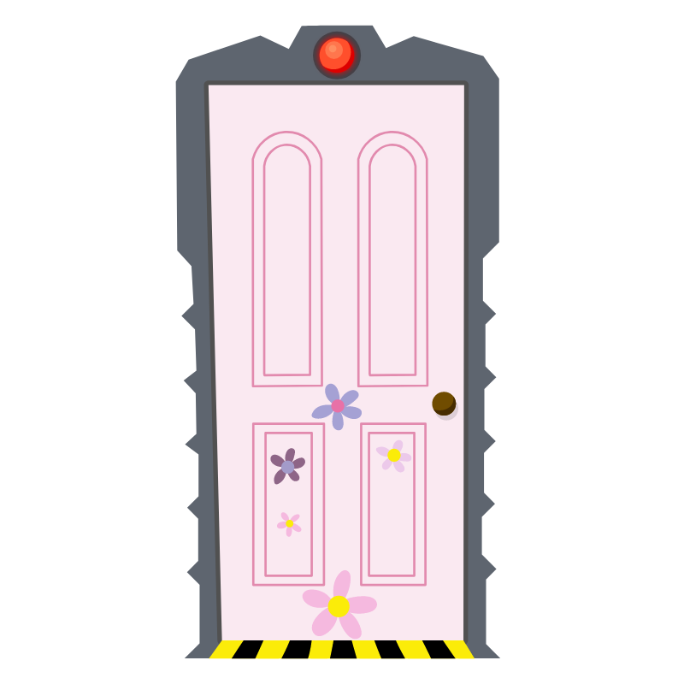
Monsters Inc
matching pairs game
Notes:
Monsters Inc Pairs Game
maecheu-teachers-tools
This template is for educational, non-commercial purposes only.
maecheu-teachers-tools.com

Slide 2
How To Play
You will be split into teams.
Each team will take it in turns choosing a pair of doors.
Notes:
How To Play:
Teams take it in turns to choose a pair of doors, if they match +1 point, if they don’t match the next team goes.
Teams only have one turn per round.
Teacher’s Notes:
Click the door to reveal the text, then again to hide it again.
maecheu-teachers-tools
This template is for educational, non-commercial purposes only.
maecheu-teachers-tools.com

Slide 3
How To Play
If the doors match,
+1 Point.
Notes:
How To Play:
Teams take it in turns to choose a pair of doors, if they match +1 point, if they don’t match the next team goes.
Teams only have one turn per round.
Teacher’s Notes:
Click the door to reveal the text, then again to hide it again.
maecheu-teachers-tools
This template is for educational, non-commercial purposes only.
maecheu-teachers-tools.com

Slide 4
Ready
Notes:
How To Play:
Teams take it in turns to choose a pair of doors, if they match +1 point, if they don’t match the next team goes.
Teams only have one turn per round.
Teacher’s Notes:
Click the door to reveal the text, then again to hide it again.
maecheu-teachers-tools
This template is for educational, non-commercial purposes only.
maecheu-teachers-tools.com

Slide 5
Text goes here.
Text goes here.
Text goes here.
Text goes here.
Text goes here.
Text goes here.
1
2
3
4
5
6
Text goes here.
Text goes here.
Text goes here.
Text goes here.
Text goes here.
Text goes here.
7
8
9
10
11
12
Notes:
How To Play:
Teams take it in turns to choose a pair of doors, if they match +1 point, if they don’t match the next team goes.
Teams only have one turn per round.
Teacher’s Notes:
Click the door to reveal the text, then again to hide it again.
maecheu-teachers-tools
This template is for educational, non-commercial purposes only.
maecheu-teachers-tools.com

Slide 6
Text goes here.
Text goes here.
Text goes here.
Text goes here.
Text goes here.
Text goes here.
1
2
3
4
5
6
Text goes here.
Text goes here.
Text goes here.
Text goes here.
Text goes here.
Text goes here.
7
8
9
10
11
12
Notes:
How To Play:
Teams take it in turns to choose a pair of doors, if they match +1 point, if they don’t match the next team goes.
Teams only have one turn per round.
Teacher’s Notes:
Click the door to reveal the text, then again to hide it again.
maecheu-teachers-tools
This template is for educational, non-commercial purposes only.
maecheu-teachers-tools.com

Slide 7
Text goes here.
Text goes here.
Text goes here.
Text goes here.
Text goes here.
Text goes here.
1
2
3
4
5
6
Text goes here.
Text goes here.
Text goes here.
Text goes here.
Text goes here.
Text goes here.
7
8
9
10
11
12
Notes:
How To Play:
Teams take it in turns to choose a pair of doors, if they match +1 point, if they don’t match the next team goes.
Teams only have one turn per round.
Teacher’s Notes:
Click the door to reveal the text, then again to hide it again.
maecheu-teachers-tools
This template is for educational, non-commercial purposes only.
maecheu-teachers-tools.com

Slide 8
Text goes here.
Text goes here.
Text goes here.
Text goes here.
Text goes here.
Text goes here.
1
2
3
4
5
6
Text goes here.
Text goes here.
Text goes here.
Text goes here.
Text goes here.
Text goes here.
7
8
9
10
11
12
Notes:
How To Play:
Teams take it in turns to choose a pair of doors, if they match +1 point, if they don’t match the next team goes.
Teams only have one turn per round.
Teacher’s Notes:
Click the door to reveal the text, then again to hide it again.
maecheu-teachers-tools
This template is for educational, non-commercial purposes only.
maecheu-teachers-tools.com

Slide 9
Text goes here.
Text goes here.
Text goes here.
Text goes here.
Text goes here.
Text goes here.
1
2
3
4
5
6
Text goes here.
Text goes here.
Text goes here.
Text goes here.
Text goes here.
Text goes here.
7
8
9
10
11
12
Notes:
How To Play:
Teams take it in turns to choose a pair of doors, if they match +1 point, if they don’t match the next team goes.
Teams only have one turn per round.
Teacher’s Notes:
Click the door to reveal the text, then again to hide it again.
maecheu-teachers-tools
This template is for educational, non-commercial purposes only.
maecheu-teachers-tools.com

Slide 10
Text goes here.
Text goes here.
Text goes here.
Text goes here.
Text goes here.
Text goes here.
1
2
3
4
5
6
Text goes here.
Text goes here.
Text goes here.
Text goes here.
Text goes here.
Text goes here.
7
8
9
10
11
12
Notes:
How To Play:
Teams take it in turns to choose a pair of doors, if they match +1 point, if they don’t match the next team goes.
Teams only have one turn per round.
Teacher’s Notes:
Click the door to reveal the text, then again to hide it again.
maecheu-teachers-tools
This template is for educational, non-commercial purposes only.
maecheu-teachers-tools.com

Slide 11
Text goes here.
Text goes here.
Text goes here.
Text goes here.
Text goes here.
Text goes here.
1
2
3
4
5
6
Text goes here.
Text goes here.
Text goes here.
Text goes here.
Text goes here.
Text goes here.
7
8
9
10
11
12
Notes:
How To Play:
Teams take it in turns to choose a pair of doors, if they match +1 point, if they don’t match the next team goes.
Teams only have one turn per round.
Teacher’s Notes:
Click the door to reveal the text, then again to hide it again.
maecheu-teachers-tools
This template is for educational, non-commercial purposes only.
maecheu-teachers-tools.com

Slide 12
Text goes here.
Text goes here.
Text goes here.
Text goes here.
Text goes here.
Text goes here.
1
2
3
4
5
6
Text goes here.
Text goes here.
Text goes here.
Text goes here.
Text goes here.
Text goes here.
7
8
9
10
11
12
Notes:
How To Play:
Teams take it in turns to choose a pair of doors, if they match +1 point, if they don’t match the next team goes.
Teams only have one turn per round.
Teacher’s Notes:
Click the door to reveal the text, then again to hide it again.
maecheu-teachers-tools
This template is for educational, non-commercial purposes only.
maecheu-teachers-tools.com

Slide 13
Finish
Notes:
How To Play:
Teams take it in turns to choose a pair of doors, if they match +1 point, if they don’t match the next team goes.
Teams only have one turn per round.
Teacher’s Notes:
Click the door to reveal the text, then again to hide it again.
maecheu-teachers-tools
This template is for educational, non-commercial purposes only.
maecheu-teachers-tools.com

