Slide 1
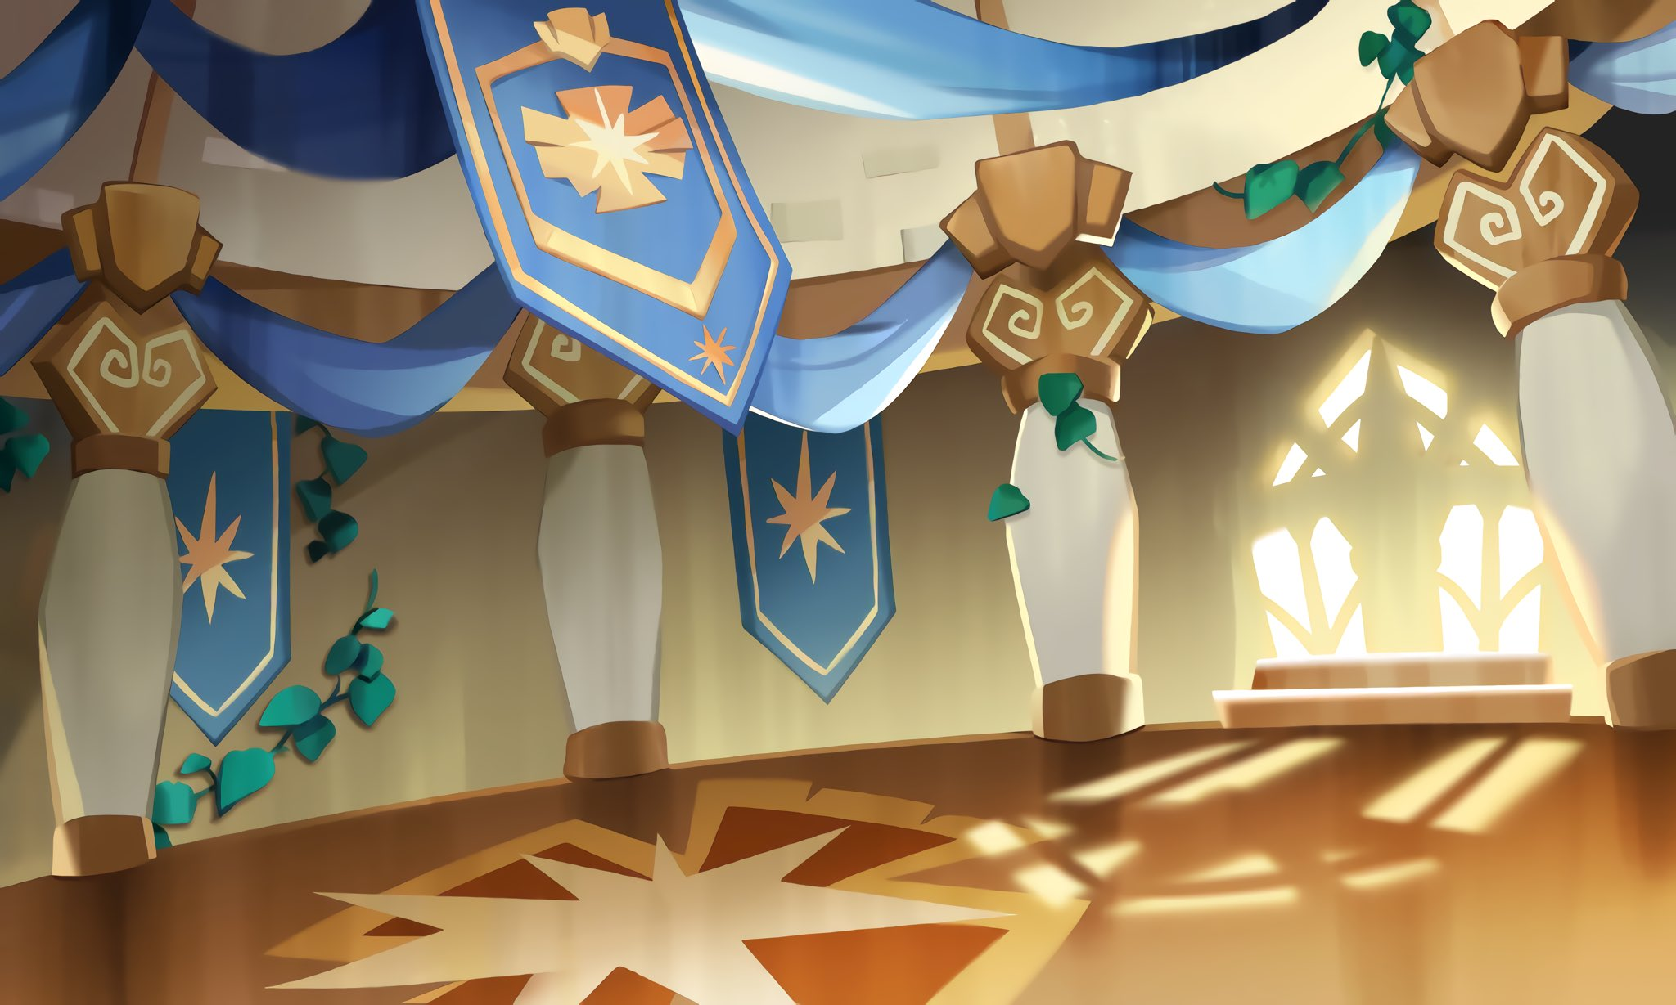

Cookie
Run
Crunch
Notes:
Cooke Run Crunch Game
maecheu-teachers-tools
This template is for educational, non-commercial purposes only.
maecheu-teachers-tools.com

Slide 2
How to play
You will be put into pairs.
At the beginning of the round you will
rock, paper, scissors.
Notes:
How To Play:
Pair Up: Everyone finds a partner, and each round will start with rock, paper, scissors.
Choose Roles: The winner decides who will say the A sentences and who will say the B sentences.
Repeat Sentences: Say your assigned sentences out loud.
Find Out Who Wins: After each round, the tiles will flip to reveal who as won between A and B.
Keep Score: The person with the most wins at the end is the overall winner.
maecheu-teachers-tools
This template is for educational, non-commercial purposes only.
maecheu-teachers-tools.com

Slide 3
How to play
The winner will choose to be A or B.
The loser will be the other one.
Notes:
How To Play:
Pair Up: Everyone finds a partner, and each round will start with rock, paper, scissors.
Choose Roles: The winner decides who will say the A sentences and who will say the B sentences.
Repeat Sentences: Say your assigned sentences out loud.
Find Out Who Wins: After each round, the tiles will flip to reveal who as won between A and B.
Keep Score: The person with the most wins at the end is the overall winner.
maecheu-teachers-tools
This template is for educational, non-commercial purposes only.
maecheu-teachers-tools.com

Slide 4

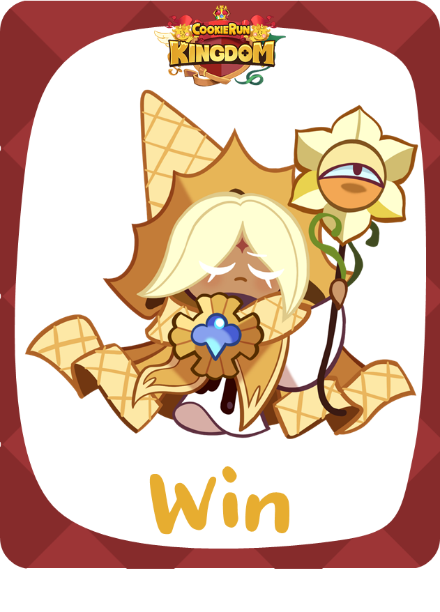
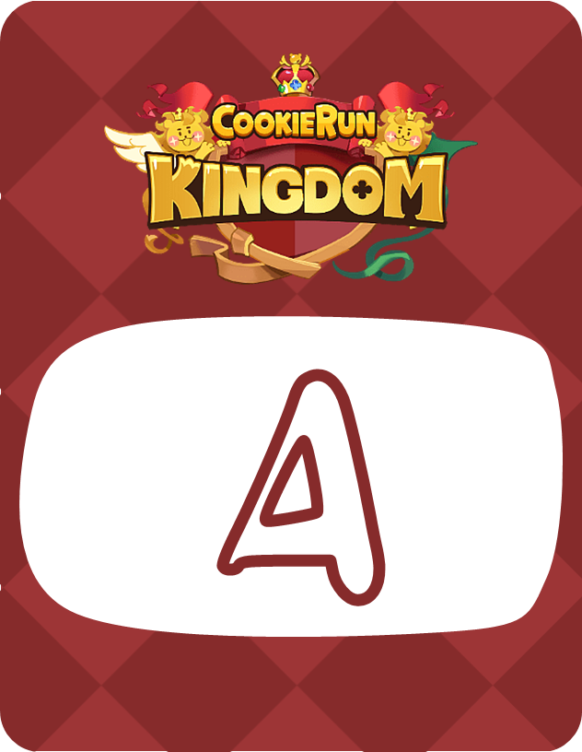

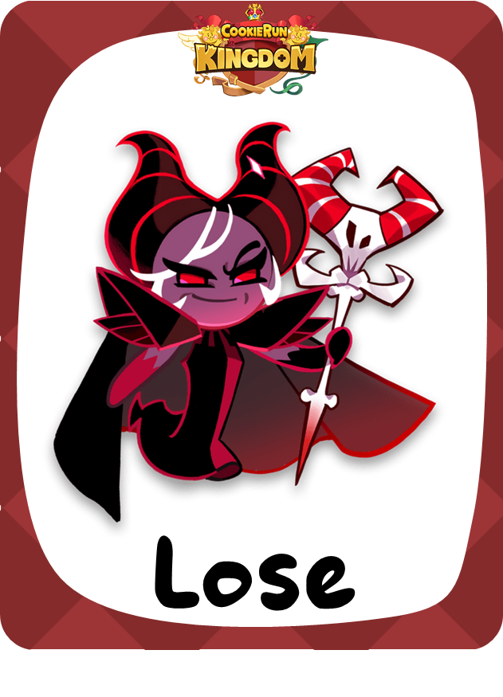
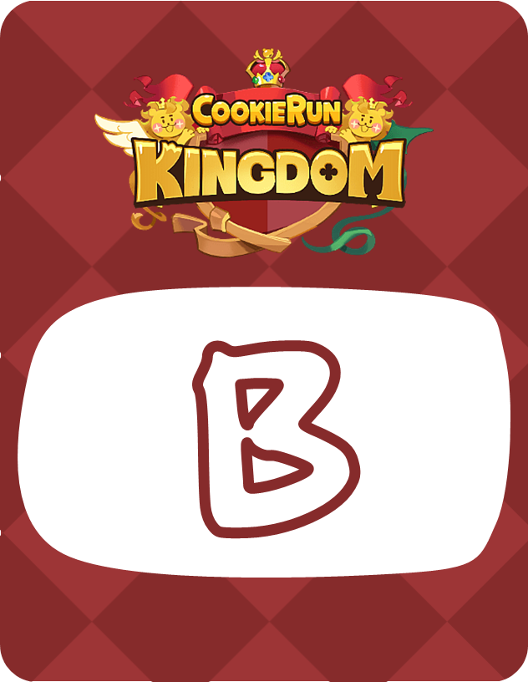
How to play
Listen and repeat the key expressions.
Text goes here.
Text goes here.
Notes:
How To Play:
Pair Up: Everyone finds a partner, and each round will start with rock, paper, scissors.
Choose Roles: The winner decides who will say the A sentences and who will say the B sentences.
Repeat Sentences: Say your assigned sentences out loud.
Find Out Who Wins: After each round, the tiles will flip to reveal who as won between A and B.
Keep Score: The person with the most wins at the end is the overall winner.
maecheu-teachers-tools
This template is for educational, non-commercial purposes only.
maecheu-teachers-tools.com

Slide 5
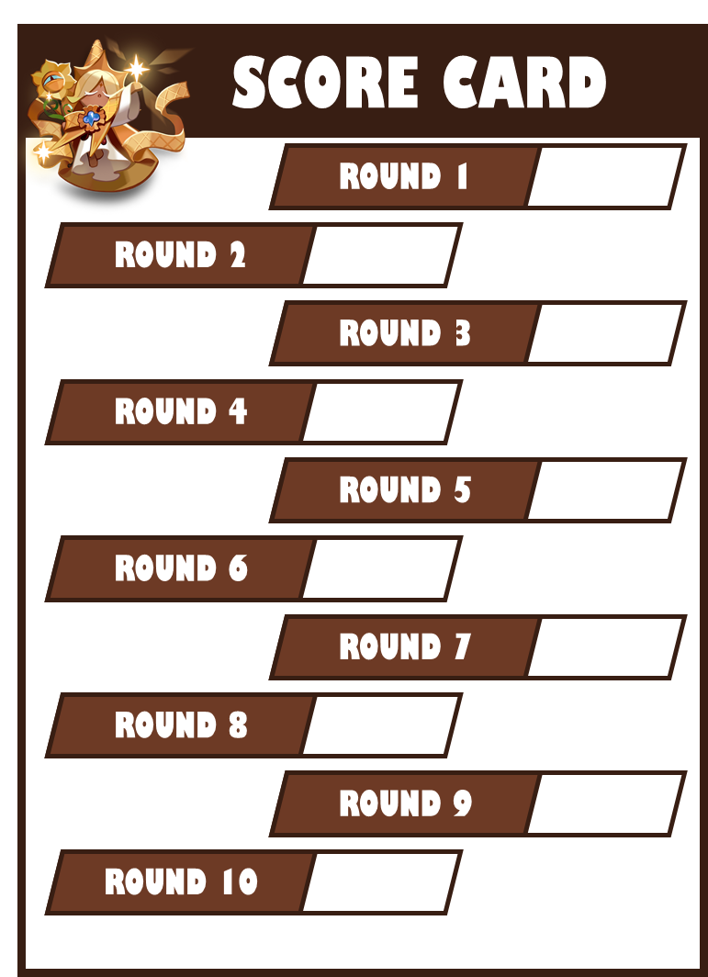
How to play
Remember to keep score on your card!
O = WIN
X = LOSE
Notes:
How To Play:
Pair Up: Everyone finds a partner, and each round will start with rock, paper, scissors.
Choose Roles: The winner decides who will say the A sentences and who will say the B sentences.
Repeat Sentences: Say your assigned sentences out loud.
Find Out Who Wins: After each round, the tiles will flip to reveal who as won between A and B.
Keep Score: The person with the most wins at the end is the overall winner.
maecheu-teachers-tools
This template is for educational, non-commercial purposes only.
maecheu-teachers-tools.com

Slide 6
Ready…

Slide 7
Rock, paper, Scissors

Slide 8
Ready…
Text goes here.
Text goes here.
Notes:
Teacher’s Notes:
Click/space bar to reveal.
Win: A
Lose: B
maecheu-teachers-tools
This template is for educational, non-commercial purposes only.
maecheu-teachers-tools.com

Slide 9
Rock, paper, Scissors

Slide 10


Ready…
Text goes here.
Text goes here.
Notes:
Teacher’s Notes:
Click/space bar to reveal.
Win: B
Lose: A
maecheu-teachers-tools
This template is for educational, non-commercial purposes only.
maecheu-teachers-tools.com

Slide 11
Rock, paper, Scissors

Slide 12
Ready…
Text goes here.
Text goes here.
Notes:
Teacher’s Notes:
Click/space bar to reveal.
Win: A
Lose: B
maecheu-teachers-tools
This template is for educational, non-commercial purposes only.
maecheu-teachers-tools.com

Slide 13
Rock, paper, Scissors

Slide 14
Ready…
Text goes here.
Text goes here.
Notes:
Teacher’s Notes:
Click/space bar to reveal.
Win: A
Lose: B
maecheu-teachers-tools
This template is for educational, non-commercial purposes only.
maecheu-teachers-tools.com

Slide 15
Rock, paper, Scissors

Slide 16
Ready…
Text goes here.
Text goes here.
Notes:
Teacher’s Notes:
Click/space bar to reveal.
Win: B
Lose: A
maecheu-teachers-tools
This template is for educational, non-commercial purposes only.
maecheu-teachers-tools.com

Slide 17
Rock, paper, Scissors

Slide 18
Ready…
Text goes here.
Text goes here.
Notes:
Teacher’s Notes:
Click/space bar to reveal.
Win: A
Lose: B
maecheu-teachers-tools
This template is for educational, non-commercial purposes only.
maecheu-teachers-tools.com

Slide 19
Rock, paper, Scissors

Slide 20
Ready…
Text goes here.
Text goes here.
Notes:
Teacher’s Notes:
Click/space bar to reveal.
Win: B
Lose: A
maecheu-teachers-tools
This template is for educational, non-commercial purposes only.
maecheu-teachers-tools.com

Slide 21
Rock, paper, Scissors

Slide 22
Ready…
Text goes here.
Text goes here.
Notes:
Teacher’s Notes:
Click/space bar to reveal.
Win: B
Lose: A
maecheu-teachers-tools
This template is for educational, non-commercial purposes only.
maecheu-teachers-tools.com

Slide 23
Rock, paper, Scissors

Slide 24
Ready…
Text goes here.
Text goes here.
Notes:
Teacher’s Notes:
Click/space bar to reveal.
Win: B
Lose: A
maecheu-teachers-tools
This template is for educational, non-commercial purposes only.
maecheu-teachers-tools.com

Slide 25
Rock, paper, Scissors

Slide 26
Ready…
Text goes here.
Text goes here.
Notes:
Teacher’s Notes:
Click/space bar to reveal.
Win: A
Lose: B
maecheu-teachers-tools
This template is for educational, non-commercial purposes only.
maecheu-teachers-tools.com

Slide 27
Finish

Slide 28
SCORE CARD
SCORE CARD
ROUND 1
ROUND 1
ROUND 2
ROUND 2
ROUND 3
ROUND 3
ROUND 4
ROUND 4
ROUND 5
ROUND 5
ROUND 6
ROUND 6
ROUND 7
ROUND 7
ROUND 8
ROUND 8
ROUND 9
ROUND 9
ROUND 10
ROUND 10

