Slide 1
Level up
game
Notes:
Valorant Level Up Game
maecheu-teachers-tools
This template is for educational, non-commercial purposes only.
maecheu-teachers-tools.com

Slide 2
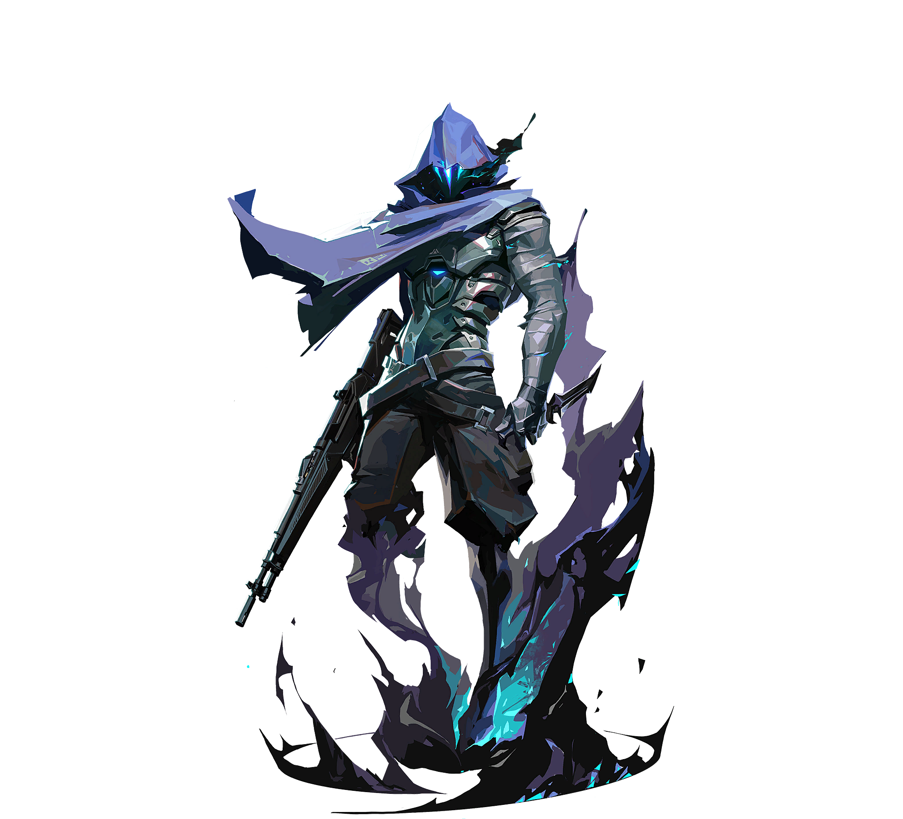
How to play
I will give you six cards.
You will all start at level one.
Notes:
How To Play:
Cards: Each student gets 6 cards and will start at level one.
Battle: Students will walk around showing their card, find someone at the same and repeat the sentences. Then they will rock, paper, scissors.
Level Up: The winner will go up +1 level, the loser will go back to the beginning.
Boss: The first winner of level 6 becomes the boss. Repeat: The game can be repeat for any length of time.
maecheu-teachers-tools
This template is for educational, non-commercial purposes only.
maecheu-teachers-tools.com

Slide 3
How to play
Hold your card high, so everyone can see it.
Find someone with the same level as you.
Notes:
How To Play:
Cards: Each student gets 6 cards and will start at level one.
Battle: Students will walk around showing their card, find someone at the same and repeat the sentences. Then they will rock, paper, scissors.
Level Up: The winner will go up +1 level, the loser will go back to the beginning.
Boss: The first winner of level 6 becomes the boss. Repeat: The game can be repeat for any length of time.
maecheu-teachers-tools
This template is for educational, non-commercial purposes only.
maecheu-teachers-tools.com

Slide 4
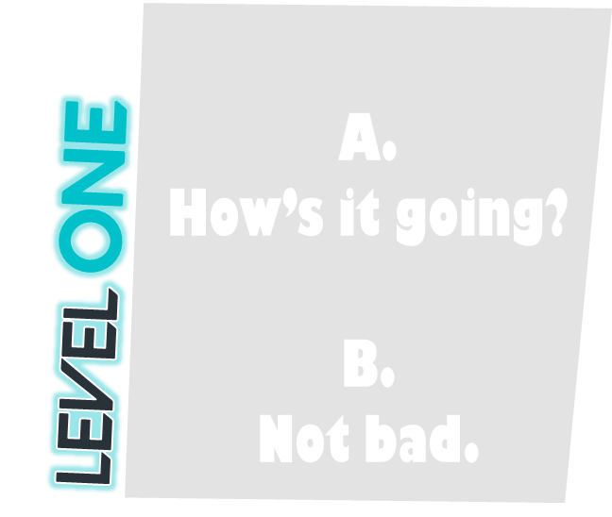
How to play
Say the key expression on your level cards.
One person will read a, the other b.
=
Notes:
How To Play:
Cards: Each student gets 6 cards and will start at level one.
Battle: Students will walk around showing their card, find someone at the same and repeat the sentences. Then they will rock, paper, scissors.
Level Up: The winner will go up +1 level, the loser will go back to the beginning.
Boss: The first winner of level 6 becomes the boss. Repeat: The game can be repeat for any length of time.
maecheu-teachers-tools
This template is for educational, non-commercial purposes only.
maecheu-teachers-tools.com

Slide 5
How to play
Do rock, paper, scissors.
The winner goes up
+1 level.
The loser goes back to level 1.
Notes:
How To Play:
Cards: Each student gets 6 cards and will start at level one.
Battle: Students will walk around showing their card, find someone at the same and repeat the sentences. Then they will rock, paper, scissors.
Level Up: The winner will go up +1 level, the loser will go back to the beginning.
Boss: The first winner of level 6 becomes the boss. Repeat: The game can be repeat for any length of time.
maecheu-teachers-tools
This template is for educational, non-commercial purposes only.
maecheu-teachers-tools.com

Slide 6
How to play
The first person to level six, will face the big boss…
The teacher
Notes:
How To Play:
Cards: Each student gets 6 cards and will start at level one.
Battle: Students will walk around showing their card, find someone at the same and repeat the sentences. Then they will rock, paper, scissors.
Level Up: The winner will go up +1 level, the loser will go back to the beginning.
Boss: The first winner of level 6 becomes the boss. Repeat: The game can be repeat for any length of time.
maecheu-teachers-tools
This template is for educational, non-commercial purposes only.
maecheu-teachers-tools.com

Slide 7
How to play
The winner becomes the new boss.
The loser goes back to level 1.
Notes:
How To Play:
Cards: Each student gets 6 cards and will start at level one.
Battle: Students will walk around showing their card, find someone at the same and repeat the sentences. Then they will rock, paper, scissors.
Level Up: The winner will go up +1 level, the loser will go back to the beginning.
Boss: The first winner of level 6 becomes the boss. Repeat: The game can be repeat for any length of time.
maecheu-teachers-tools
This template is for educational, non-commercial purposes only.
maecheu-teachers-tools.com

Slide 8
begin
Notes:
maecheu-teachers-tools
This template is for educational, non-commercial purposes only.
maecheu-teachers-tools.com

Slide 9
1.
Text goes here.
2.
Text goes here.
3.
Text goes here.
Level one
Level two
Level three
4.
Text goes here.
5.
Text goes here.
6.
Text goes here.
Level four
Level five
Level six
Notes:
maecheu-teachers-tools
This template is for educational, non-commercial purposes only.
maecheu-teachers-tools.com

Slide 10
1.
Text goes here.
2.
Text goes here.
3.
Text goes here.
Level one
Level two
Level three
4.
Text goes here.
5.
Text goes here.
6.
Text goes here.
Level four
Level five
Level six
Notes:
maecheu-teachers-tools
This template is for educational, non-commercial purposes only.
maecheu-teachers-tools.com

Slide 11
1.
Text goes here.
2.
Text goes here.
3.
Text goes here.
Level one
Level two
Level three
4.
Text goes here.
5.
Text goes here.
6.
Text goes here.
Level four
Level five
Level six
Notes:
maecheu-teachers-tools
This template is for educational, non-commercial purposes only.
maecheu-teachers-tools.com

Slide 12
finish
Notes:
maecheu-teachers-tools
This template is for educational, non-commercial purposes only.
maecheu-teachers-tools.com

Slide 13
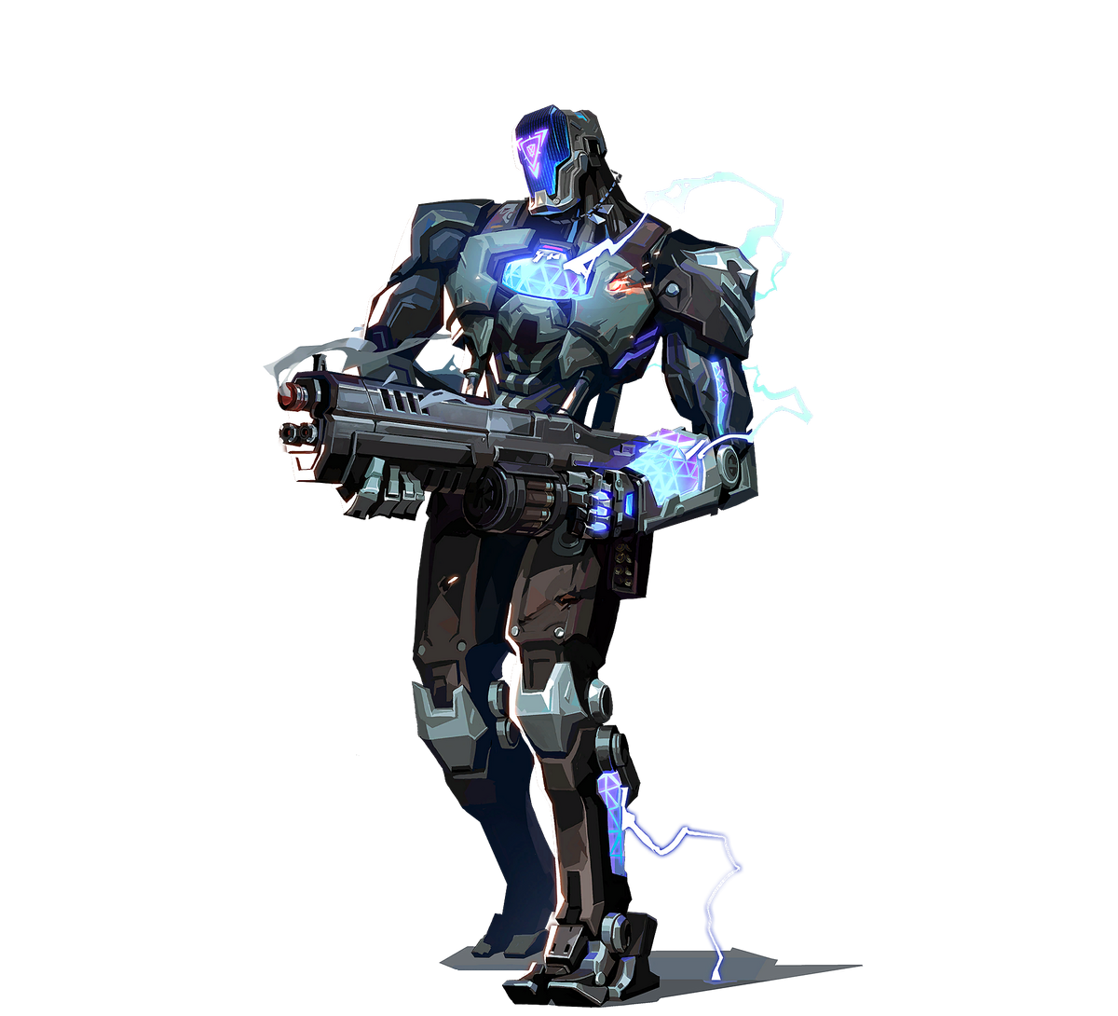
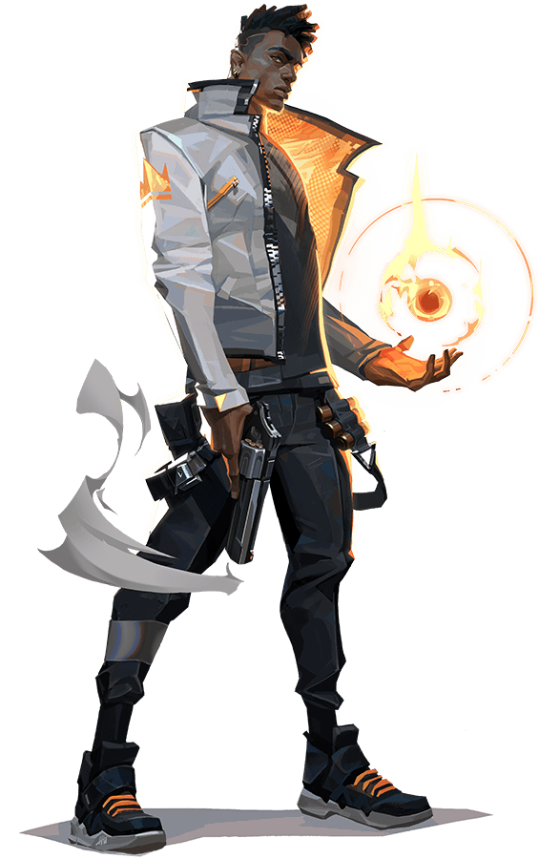
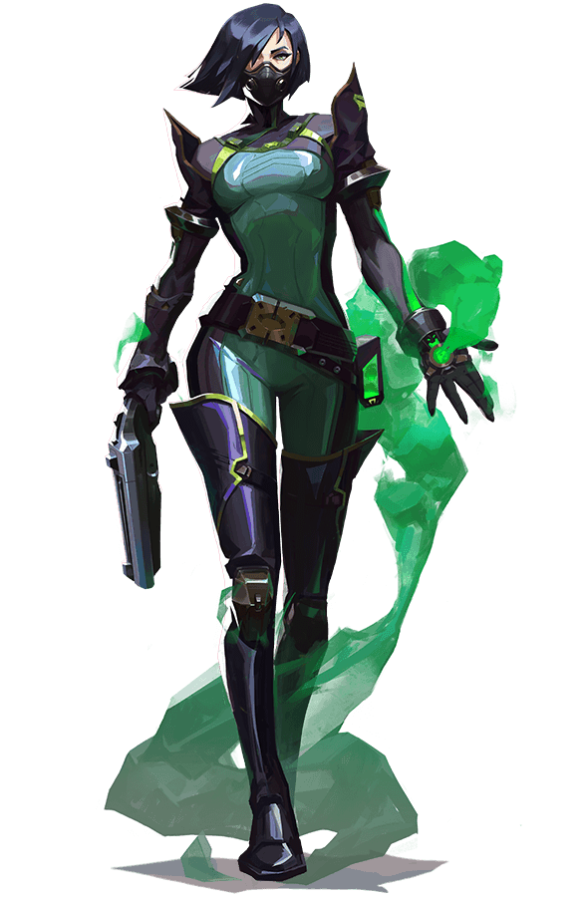
Valorant
Valorant
Valorant
Level ONE
Level two
Level three
1
2
3
Notes:
maecheu-teachers-tools
This template is for educational, non-commercial purposes only.
maecheu-teachers-tools.com

Slide 14
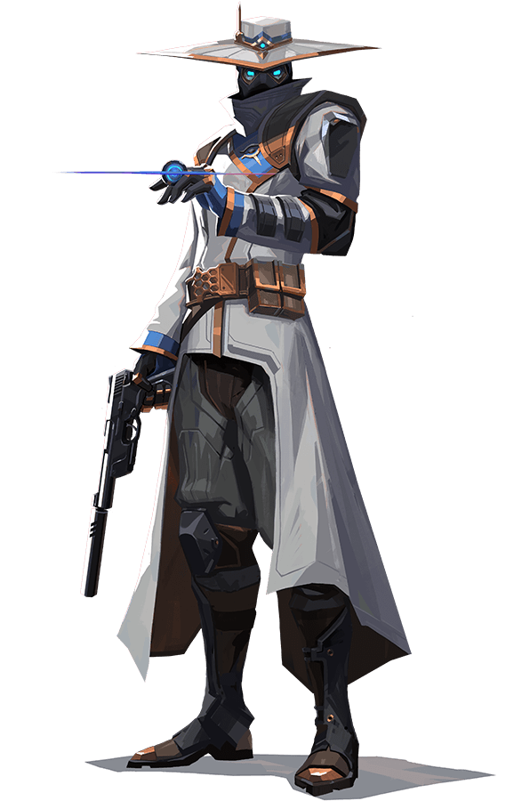
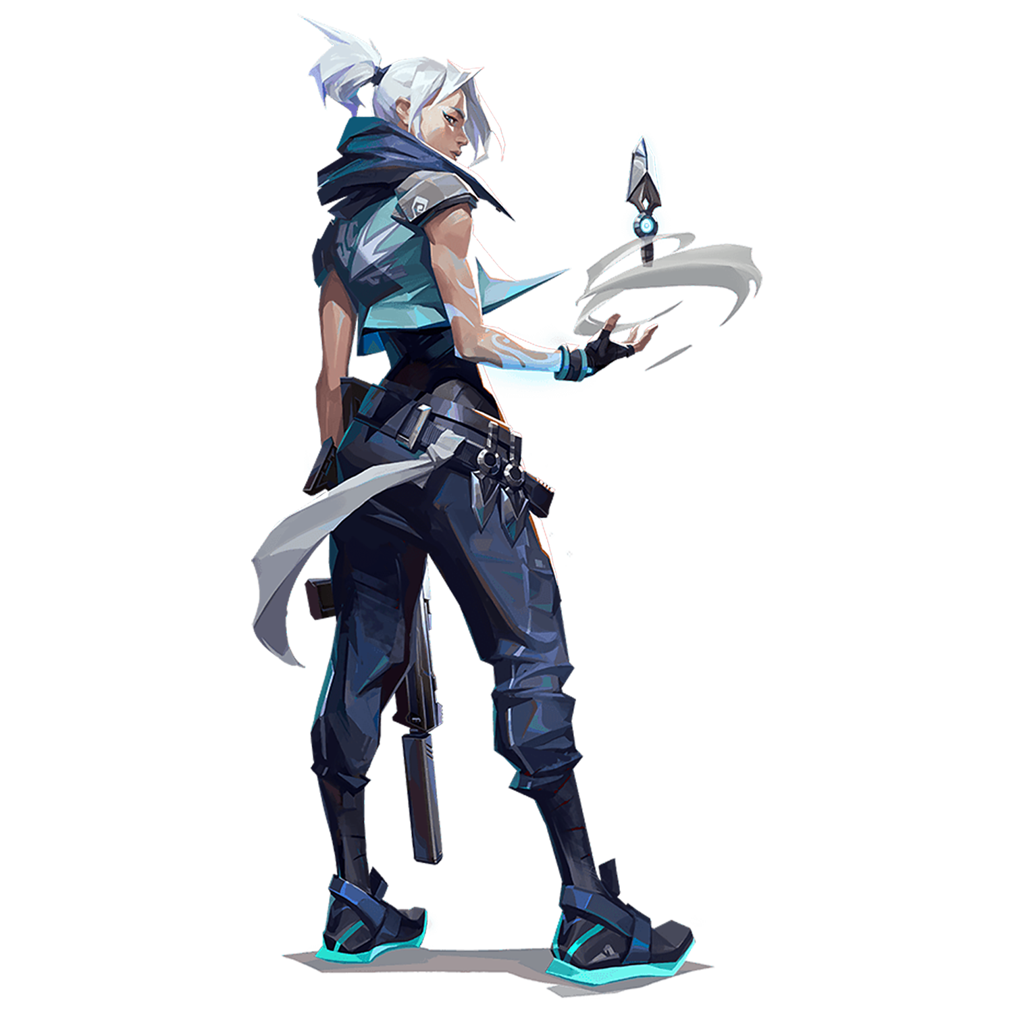
Valorant
Valorant
Valorant
Level four
Level five
Level six
1
2
4
5
6
Notes:
maecheu-teachers-tools
This template is for educational, non-commercial purposes only.
maecheu-teachers-tools.com

