Slide 1
TEACHER
students
VS
Notes:
Pikachu’s Teacher Vs Students
maecheu-teachers-tools
This template is for educational, non-commercial purposes only.
maecheu-teachers-tools.com

Slide 2
How to play
I will show you a number.
Notes:
How To Play:
See the Number: I will show you a number that matches the number of students.
Team Decision: Your team decides if the number means that many students should stand up or sit down.
Act It Out: Groups will repeat the sentences, first standing up and then sitting down, in an A-B format.
Pikachu Shows the Answer: The Pikachu icon will reveal the correct action (standing or sitting).
Score Points:
If your choice matches Pikachu’s answer, your team earns one point. (For example, if the number is 5 and 5 students stand up when Pikachu shows 5 students standing, you get a point.)
If your choice does not match, the teacher scores a point. (For example, if the number is 5 and 5 students stand up but Pikachu shows 5 students sitting, the teacher gets a point.)
maecheu-teachers-tools
This template is for educational, non-commercial purposes only.
maecheu-teachers-tools.com

Slide 3
How to play
Decide if the number means 4 students should stand up.
Or if 4 students should sit down.
Notes:
How To Play:
See the Number: I will show you a number that matches the number of students.
Team Decision: Your team decides if the number means that many students should stand up or sit down.
Act It Out: Groups will repeat the sentences, first standing up and then sitting down, in an A-B format.
Pikachu Shows the Answer: The Pikachu icon will reveal the correct action (standing or sitting).
Score Points:
If your choice matches Pikachu’s answer, your team earns one point. (For example, if the number is 5 and 5 students stand up when Pikachu shows 5 students standing, you get a point.)
If your choice does not match, the teacher scores a point. (For example, if the number is 5 and 5 students stand up but Pikachu shows 5 students sitting, the teacher gets a point.)
maecheu-teachers-tools
This template is for educational, non-commercial purposes only.
maecheu-teachers-tools.com

Slide 4
How to play
You will have 20 seconds to decide.
Notes:
How To Play:
See the Number: I will show you a number that matches the number of students.
Team Decision: Your team decides if the number means that many students should stand up or sit down.
Act It Out: Groups will repeat the sentences, first standing up and then sitting down, in an A-B format.
Pikachu Shows the Answer: The Pikachu icon will reveal the correct action (standing or sitting).
Score Points:
If your choice matches Pikachu’s answer, your team earns one point. (For example, if the number is 5 and 5 students stand up when Pikachu shows 5 students standing, you get a point.)
If your choice does not match, the teacher scores a point. (For example, if the number is 5 and 5 students stand up but Pikachu shows 5 students sitting, the teacher gets a point.)
maecheu-teachers-tools
This template is for educational, non-commercial purposes only.
maecheu-teachers-tools.com

Slide 5
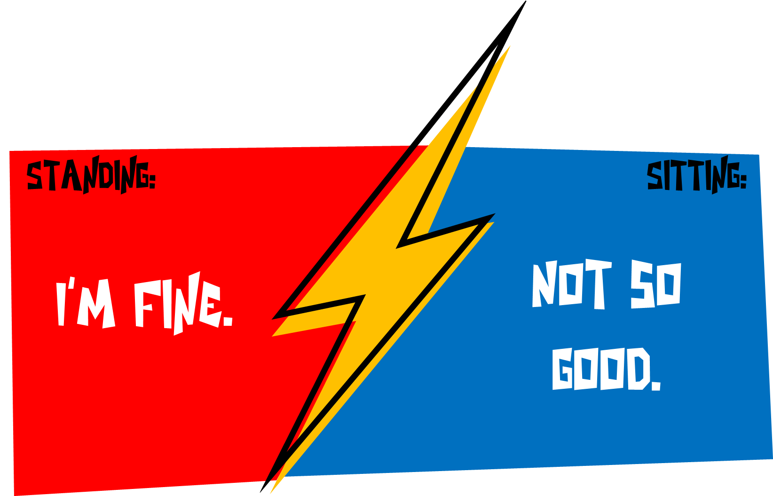
How to play
The groups will repeat the sentences.
Notes:
How To Play:
See the Number: I will show you a number that matches the number of students.
Team Decision: Your team decides if the number means that many students should stand up or sit down.
Act It Out: Groups will repeat the sentences, first standing up and then sitting down, in an A-B format.
Pikachu Shows the Answer: The Pikachu icon will reveal the correct action (standing or sitting).
Score Points:
If your choice matches Pikachu’s answer, your team earns one point. (For example, if the number is 5 and 5 students stand up when Pikachu shows 5 students standing, you get a point.)
If your choice does not match, the teacher scores a point. (For example, if the number is 5 and 5 students stand up but Pikachu shows 5 students sitting, the teacher gets a point.)
maecheu-teachers-tools
This template is for educational, non-commercial purposes only.
maecheu-teachers-tools.com

Slide 6
How to play
Pikachu will reveal the answer.
Notes:
How To Play:
See the Number: I will show you a number that matches the number of students.
Team Decision: Your team decides if the number means that many students should stand up or sit down.
Act It Out: Groups will repeat the sentences, first standing up and then sitting down, in an A-B format.
Pikachu Shows the Answer: The Pikachu icon will reveal the correct action (standing or sitting).
Score Points:
If your choice matches Pikachu’s answer, your team earns one point. (For example, if the number is 5 and 5 students stand up when Pikachu shows 5 students standing, you get a point.)
If your choice does not match, the teacher scores a point. (For example, if the number is 5 and 5 students stand up but Pikachu shows 5 students sitting, the teacher gets a point.)
maecheu-teachers-tools
This template is for educational, non-commercial purposes only.
maecheu-teachers-tools.com

Slide 7
How to play
If your choice matches Pikachu’s answer, your team earns +1 point.
(For example, if the number is 7 and 7 students stand up when Pikachu shows 7 students standing, you get a point.)
Notes:
How To Play:
See the Number: I will show you a number that matches the number of students.
Team Decision: Your team decides if the number means that many students should stand up or sit down.
Act It Out: Groups will repeat the sentences, first standing up and then sitting down, in an A-B format.
Pikachu Shows the Answer: The Pikachu icon will reveal the correct action (standing or sitting).
Score Points:
If your choice matches Pikachu’s answer, your team earns one point. (For example, if the number is 5 and 5 students stand up when Pikachu shows 5 students standing, you get a point.)
If your choice does not match, the teacher scores a point. (For example, if the number is 5 and 5 students stand up but Pikachu shows 5 students sitting, the teacher gets a point.)
maecheu-teachers-tools
This template is for educational, non-commercial purposes only.
maecheu-teachers-tools.com

Slide 8
How to play
If your choice does not match, the teacher earns +1 point.
(For example, if the number is 7 and 7 students stand up when Pikachu shows 7 students sitting, The teacher gets a point.)
Notes:
How To Play:
See the Number: I will show you a number that matches the number of students.
Team Decision: Your team decides if the number means that many students should stand up or sit down.
Act It Out: Groups will repeat the sentences, first standing up and then sitting down, in an A-B format.
Pikachu Shows the Answer: The Pikachu icon will reveal the correct action (standing or sitting).
Score Points:
If your choice matches Pikachu’s answer, your team earns one point. (For example, if the number is 5 and 5 students stand up when Pikachu shows 5 students standing, you get a point.)
If your choice does not match, the teacher scores a point. (For example, if the number is 5 and 5 students stand up but Pikachu shows 5 students sitting, the teacher gets a point.)
maecheu-teachers-tools
This template is for educational, non-commercial purposes only.
maecheu-teachers-tools.com

Slide 9
Ready?
Notes:
maecheu-teachers-tools
This template is for educational, non-commercial purposes only.
maecheu-teachers-tools.com

Slide 10
4
4
Standing:
Sitting:
Text goes here
Text goes here
Notes:
Teacher’s Notes:
Click/space bar to reveal.
Answer: Sitting
maecheu-teachers-tools
This template is for educational, non-commercial purposes only.
maecheu-teachers-tools.com

Slide 11
7
4
Standing:
Sitting:
Text goes here
Text goes here
Notes:
Teacher’s Notes:
Click/space bar to reveal.
Answer: Sitting
maecheu-teachers-tools
This template is for educational, non-commercial purposes only.
maecheu-teachers-tools.com

Slide 12
12
4
Standing:
Sitting:
Text goes here
Text goes here
Notes:
Teacher’s Notes:
Click/space bar to reveal.
Answer: Standing
maecheu-teachers-tools
This template is for educational, non-commercial purposes only.
maecheu-teachers-tools.com

Slide 13
9
4
Standing:
Sitting:
Text goes here
Text goes here
Notes:
Teacher’s Notes:
Click/space bar to reveal.
Answer: Sitting
maecheu-teachers-tools
This template is for educational, non-commercial purposes only.
maecheu-teachers-tools.com

Slide 14
16
4
Standing:
Sitting:
Text goes here
Text goes here
Notes:
Teacher’s Notes:
Click/space bar to reveal.
Answer: Standing
maecheu-teachers-tools
This template is for educational, non-commercial purposes only.
maecheu-teachers-tools.com

Slide 15
3
4
Standing:
Sitting:
Text goes here
Text goes here
Notes:
Teacher’s Notes:
Click/space bar to reveal.
Answer: Standing
maecheu-teachers-tools
This template is for educational, non-commercial purposes only.
maecheu-teachers-tools.com

Slide 16
12
4
Standing:
Sitting:
Text goes here
Text goes here
Notes:
Teacher’s Notes:
Click/space bar to reveal.
Answer: Standing
maecheu-teachers-tools
This template is for educational, non-commercial purposes only.
maecheu-teachers-tools.com

Slide 17
1
4
Standing:
Sitting:
Text goes here
Text goes here
Notes:
Teacher’s Notes:
Click/space bar to reveal.
Answer: Sitting
maecheu-teachers-tools
This template is for educational, non-commercial purposes only.
maecheu-teachers-tools.com

Slide 18
4
4
Standing:
Sitting:
Text goes here
Text goes here
Notes:
Teacher’s Notes:
Click/space bar to reveal.
Answer: Standing
maecheu-teachers-tools
This template is for educational, non-commercial purposes only.
maecheu-teachers-tools.com

Slide 19
9
4
Standing:
Sitting:
Text goes here
Text goes here
Notes:
Teacher’s Notes:
Click/space bar to reveal.
Answer: Sitting
maecheu-teachers-tools
This template is for educational, non-commercial purposes only.
maecheu-teachers-tools.com

Slide 20
Finish
Notes:
maecheu-teachers-tools
This template is for educational, non-commercial purposes only.
maecheu-teachers-tools.com

